Slide 1




Marketing & Branding
Netwide Media Group | Top Pro Media Group 5801 Congress Ave Boca Raton, FL 33487 | 888-294-4473

Slide 2

Marketing & Branding
What is Brand Identity?
A promise that gets kept consistently
Defines your organization
It creates a personality and a life for your products/services
A unique & consistent look, feel, tone & voice for all communications
Conveys-at a-glance the distinctive attributes of your organization
Over time, it builds awareness of & an attitude towards your organization
Strengthens the impact of all messages
Paves the way for new customer relationships
Provides employees with a greater sense of commitment
It’s essential to your success in the marketplace
No business is too small & no product too generic to develop a brand identity
Netwide Media Group | Top Pro Media Group 5801 Congress Ave Boca Raton, FL 33487 | 888-294-4473

Slide 3



Marketing & Branding
Key Brand Elements
Brand Name: name, tagline, logo
Brand Position: description of your organization
Brand Promise: the single most important thing your organization promises to deliver every time
Brand Personality: what you want your brand to be known for (fun, serious, magical, forceful, imaginative, etc.)
Brand Tone: edgy, humorous, conservative, subtle
Brand Story: your organizational history & how it adds value to the brand, highlights how your products and services grew from that background & how your methodology impacts what you offer
Brand Associations: colors, taglines, images, fonts, uniforms, signage, equipment, etc.
Netwide Media Group | Top Pro Media Group 5801 Congress Ave Boca Raton, FL 33487 | 888-294-4473

Slide 4

Marketing & Branding
Brand Building
How we build a brand
Public Relations
Communications/Marketing Strategy
Logo/Tagline
Website
Products
Stationary Package
Newsletter
Publications
Direct Mail
PowerPoint
Advertisements
Exhibit Booth
Environment
Create Corporate ID
Intranet
E-marketing
E-newsletter
Folder
Brochures
Annual Reports
Video/DVD
Flyers
Posters
Conference Materials
Lobbies
Rooms
Stores
Netwide Media Group | Top Pro Media Group 5801 Congress Ave Boca Raton, FL 33487 | 888-294-4473

Slide 5

Marketing & Branding
Marketing Vehicles
Brochures
Print & E-Newsletters
Website, Screen Savers
Events
Banner Ads
Print Ads
Public Relations
Direct Mail
Flyers & Posters
Transit Media
Power Point Presentations
Exhibit Booth/Signage
CD/Multimedia
Facilities
Netwide Media Group | Top Pro Media Group 5801 Congress Ave Boca Raton, FL 33487 | 888-294-4473

Slide 6

Marketing & Branding
Determine The Purpose
Each marketing vehicle requires a unique tweak
of the brand to fit the medium.
Brochures need more marketing copy and detail
Websites are a quick read, interactive with the audience
Ads are mini billboards, only the most critical info required
Posters are colorful and entertaining
Newsletters are informational, with regular features
Exhibit booths are backdrops
Multimedia is entertainment/educational
Netwide Media Group | Top Pro Media Group 5801 Congress Ave Boca Raton, FL 33487 | 888-294-4473

Slide 7

Marketing & Branding
Branding Costs
It depends on what you want
Bundling projects will save you money
Itemizing each project will cost you more
The cost range for branding is broad and will be determined based on scope of work
Don’t buy low bid! You get what you pay for as in any other industry or service
Projects are based on hourly rates
Hourly rates usually range from $125-$200
Netwide Media Group | Top Pro Media Group 5801 Congress Ave Boca Raton, FL 33487 | 888-294-4473

Slide 8

Marketing & Branding
Branding Steps
Step One
Learn marketing objectives & strategy
Prioritize projects
Audit existing and competitive materials & strategies
Interviews/focus group
Write creative brief and define messages
Create timelines & budgets
Step Two
Develop concepts/taglines/site architecture
Start visual research
Present initial creative approaches
Step Three
Develop outline and copy points per selected concept
Develop media strategy
Explore layout options
Begin creating visual materials (photos/illustrations)
Step Four
Write full copy draft
Revise & write final copy as per client comments
Start layouts
Step Five
Create and present full layout and/or e-design
Step Six
Develop final electronic files for print, or coding for web
Final execution and management of products (website launch, launch media campaign, exhibit built, print pieces to printer, ads placed, press releases sent, etc.)
Netwide Media Group | Top Pro Media Group 5801 Congress Ave Boca Raton, FL 33487 | 888-294-4473

Slide 9
Marketing & Branding
Branding Samples
SAMPLE: [LIV] Institute
Netwide Media Group | Top Pro Media Group 5801 Congress Ave Boca Raton, FL 33487 | 888-294-4473

Slide 10


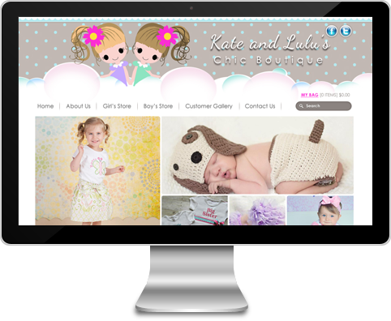


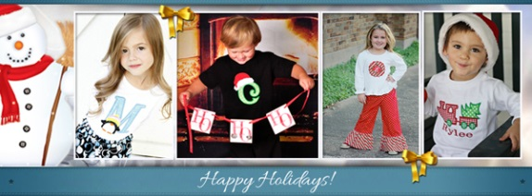
Marketing & Branding
Branding Samples
SAMPLE: Children’s Clothing
Netwide Media Group | Top Pro Media Group 5801 Congress Ave Boca Raton, FL 33487 | 888-294-4473

Slide 11
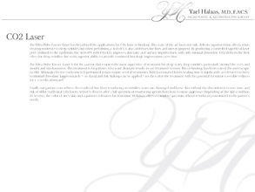

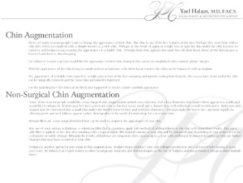
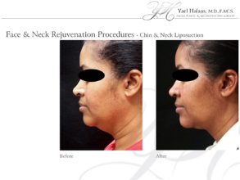
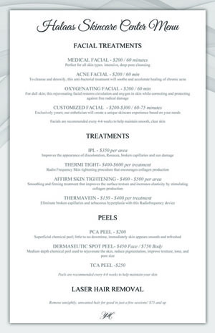
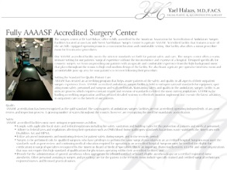











Marketing & Branding
Branding Samples
SAMPLE: Facial Plastic Surgeon
Netwide Media Group | Top Pro Media Group 5801 Congress Ave Boca Raton, FL 33487 | 888-294-4473

Slide 12




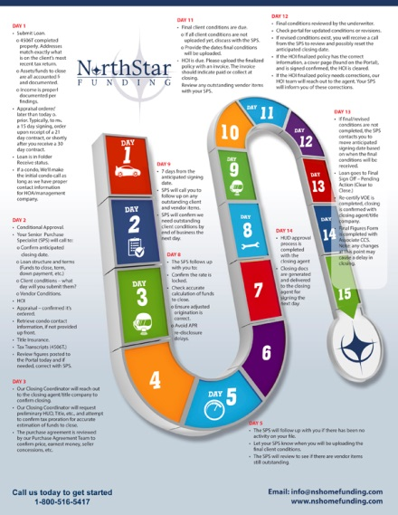



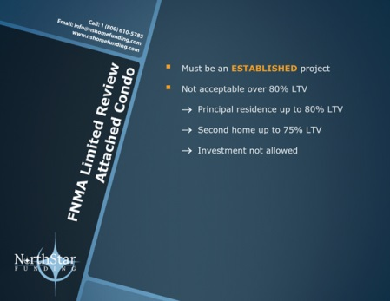
Marketing & Branding
Branding Samples
SAMPLE: Mortgage & Funding
Netwide Media Group | Top Pro Media Group 5801 Congress Ave Boca Raton, FL 33487 | 888-294-4473

Slide 13



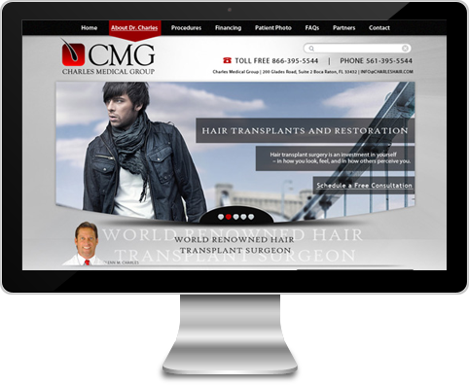
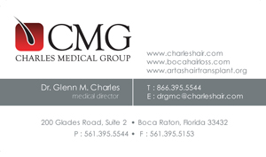


Marketing & Branding
Branding Samples
SAMPLE: Hair Transplant Surgeon
Netwide Media Group | Top Pro Media Group 5801 Congress Ave Boca Raton, FL 33487 | 888-294-4473

Slide 14

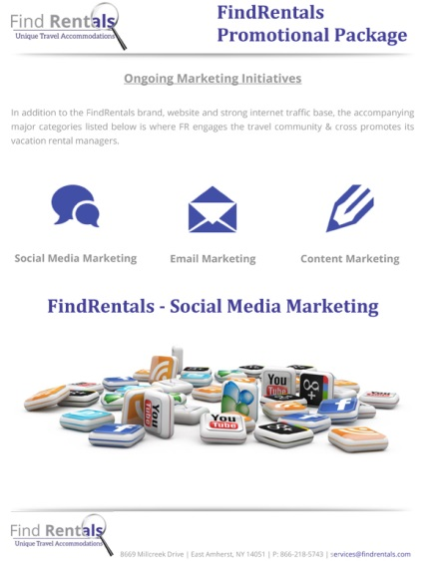

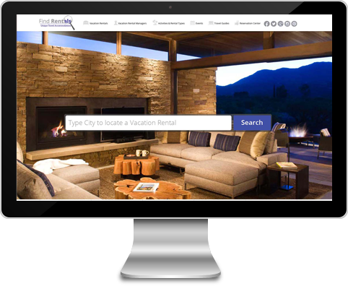
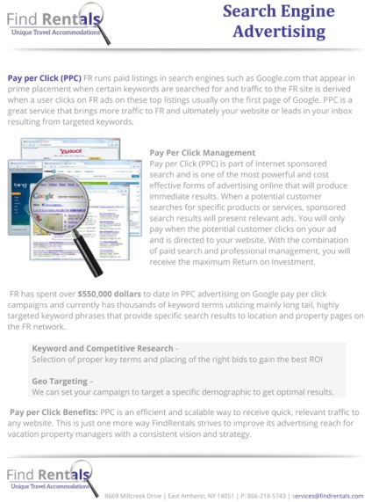
Marketing & Branding
Branding Samples
SAMPLE: Travel/Rental/Vacation Homes
Netwide Media Group | Top Pro Media Group 5801 Congress Ave Boca Raton, FL 33487 | 888-294-4473

Slide 15
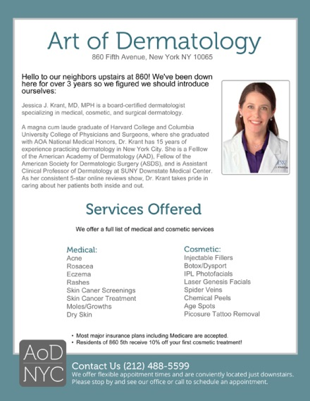

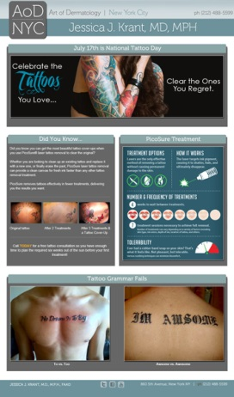

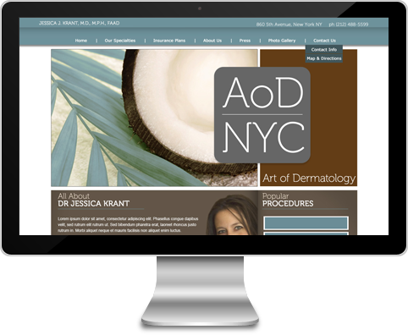



Marketing & Branding
Branding Samples
SAMPLE: Dermatologist
Netwide Media Group | Top Pro Media Group 5801 Congress Ave Boca Raton, FL 33487 | 888-294-4473

Slide 16
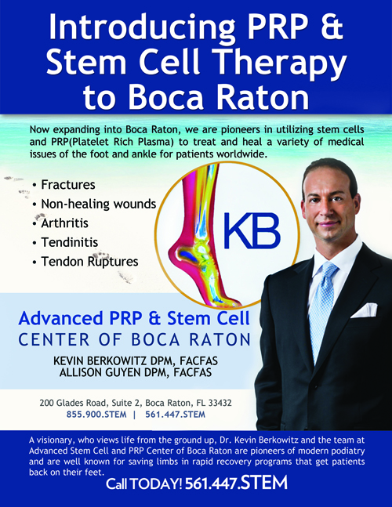
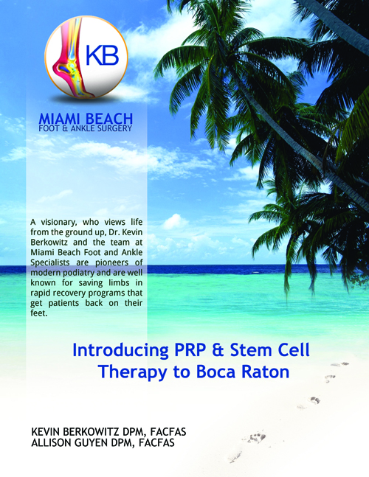

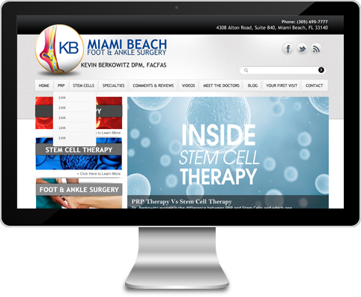
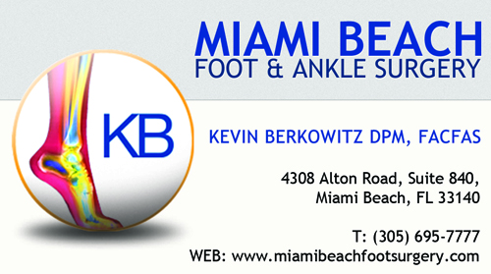

Marketing & Branding
Branding Samples
SAMPLE: Foot & Ankle
Netwide Media Group | Top Pro Media Group 5801 Congress Ave Boca Raton, FL 33487 | 888-294-4473

Slide 17
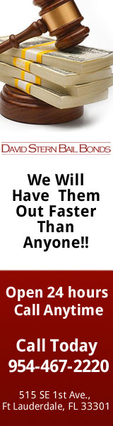


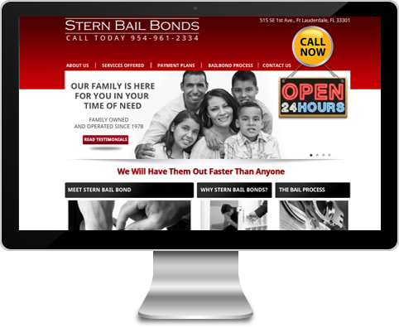

Marketing & Branding
Branding Samples
SAMPLE: Bail Bonds
Netwide Media Group | Top Pro Media Group 5801 Congress Ave Boca Raton, FL 33487 | 888-294-4473

Slide 18

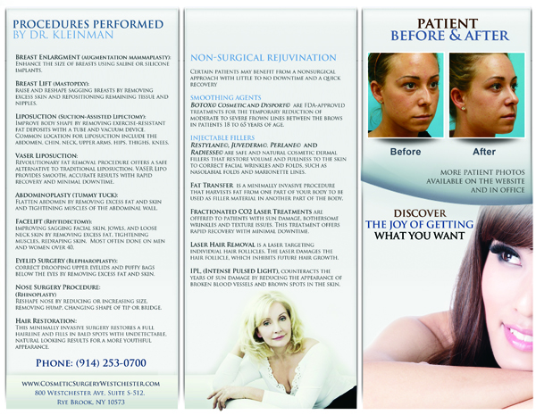



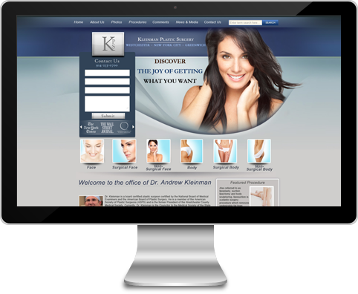


Marketing & Branding
Branding Samples
SAMPLE: Plastic Surgeon
Netwide Media Group | Top Pro Media Group 5801 Congress Ave Boca Raton, FL 33487 | 888-294-4473

Slide 19

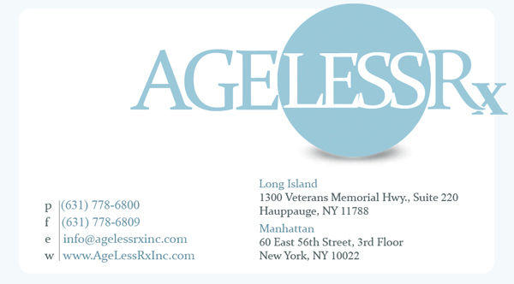
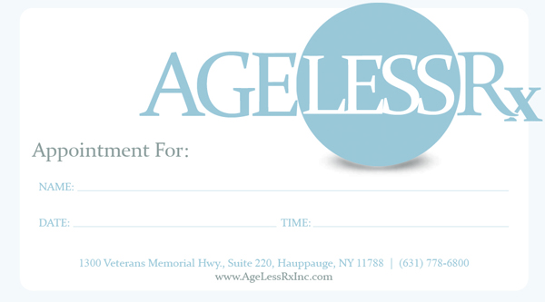




Marketing & Branding
Branding Samples
SAMPLE: MedSpa
Netwide Media Group | Top Pro Media Group 5801 Congress Ave Boca Raton, FL 33487 | 888-294-4473

Slide 20
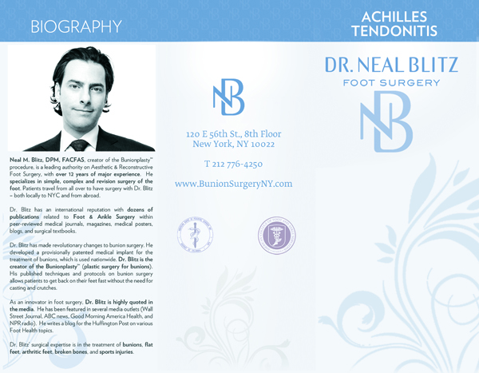

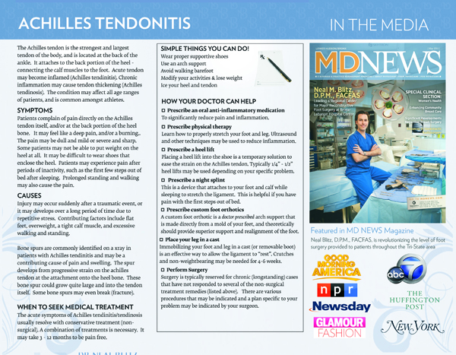

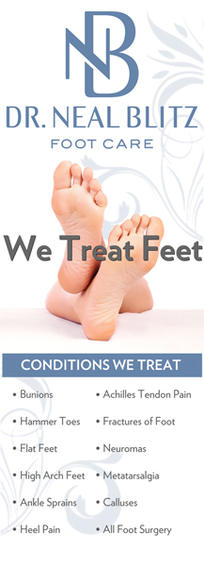
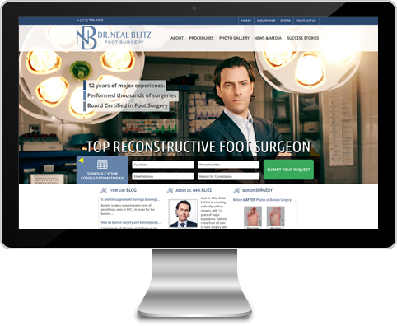
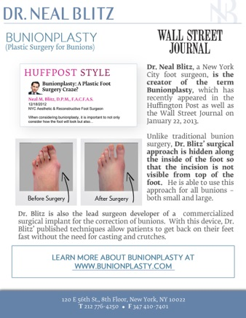


Marketing & Branding
Branding Samples
SAMPLE: Podiatrist
Netwide Media Group | Top Pro Media Group 5801 Congress Ave Boca Raton, FL 33487 | 888-294-4473

Slide 21

Marketing & Branding
Keys To Building Successful Brands
Find the right advertising/branding agency
Top management must be committed to this effort
Assign one point person to work with the agency
Do not make decisions by committee
Keep brand consistent internally & externally
Don’t rush the process-make sure you have enough time budgeted
Give the brand time to work
Create a brand style guide & give to every employee
Refresh/update brand after a few years
Netwide Media Group | Top Pro Media Group 5801 Congress Ave Boca Raton, FL 33487 | 888-294-4473

Slide 22

Marketing & Branding
What A Good Brand Does
Strengthens employees loyalty
Attracts clients/customers
Keeps current relationships strong
Builds confidence
Builds feelings of security & trust
Creates a memorable, positive experience
Netwide Media Group | Top Pro Media Group 5801 Congress Ave Boca Raton, FL 33487 | 888-294-4473

Slide 23
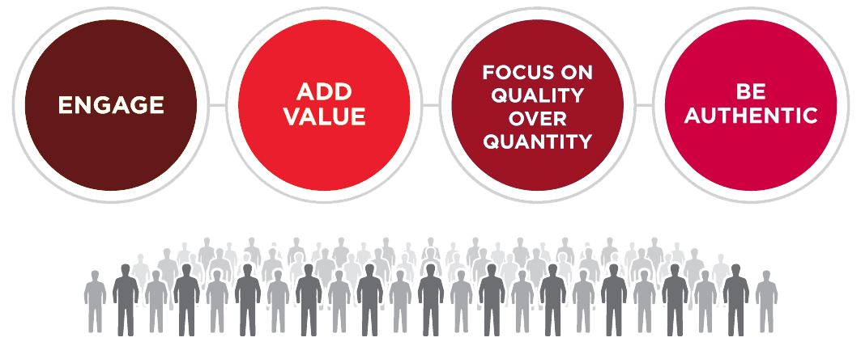
Marketing & Branding
Time To Create!
Now that you have solid messaging, it’s time to create.
Consistency is the #1 rule
Repetition, repetition, repetition
Did you know it takes 7-9 times of being exposed to your company name for a potential client to remember it?
We get exposed to over 4000 messages a day. How can you break through that clutter?
Netwide Media Group | Top Pro Media Group 5801 Congress Ave Boca Raton, FL 33487 | 888-294-4473

Slide 24
Marketing & Branding
Thank You For Your Time!
Presented by:
Netwide Media Group & Top Pro Media Group
© 2014
Netwide Media Group | Top Pro Media Group
Netwide Media Group | Top Pro Media Group 5801 Congress Ave Boca Raton, FL 33487 | 888-294-4473

